Slide 1


MICROSOFT EMS COMMUNITY
WELCOME TO
MDE Common Mistakes from the field
FRI · 04.09.2026
Defender
Talk by Albin Klinaku, AdVision.

Slide 2



TODAY'S SPEAKER
Albin Klinaku
Founder, Tech Lead @ AdVision Swiss AG
in/albinklinaku/
indefent.com
Hosted by Microsoft EMS Discord Staff Team
Microsoft EMS Community · September 2026

Slide 3

Cyberattacks WTF!?
Microsoft EMS Community · September 2026

Slide 4
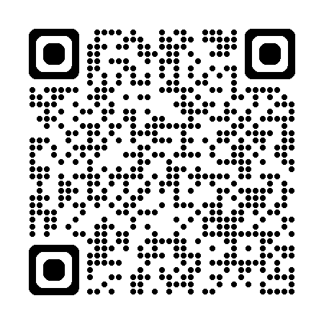
3,900+ Servers and 302 Providers
In Eastern Europe 🤡
Source: hunt.io
Microsoft EMS Community · September 2026

Slide 5
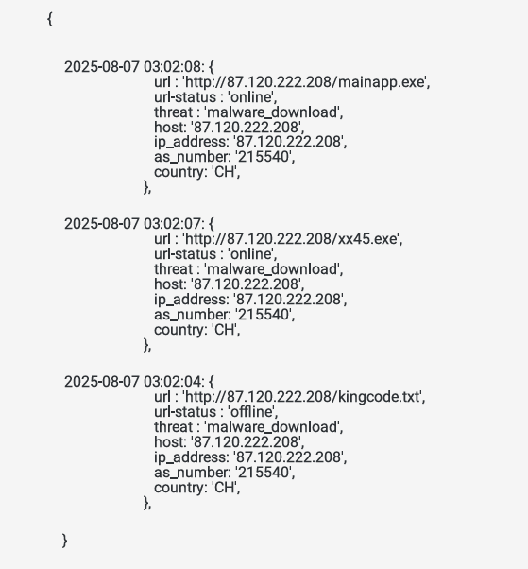
4650 Malware C&C Infra in Switzerland 🤡
Source: SOCRadar Labs
Microsoft EMS Community · September 2026

Slide 6
~171 (known) ransomware attacks per month
8 Ransomeware Gangs
Lockbit
Blackcat
11 Threat Actors
Akira
Conti
Ransomex
Suncrypts
Source: ENISA
Microsoft EMS Community · September 2026

Slide 7
Top Ransomware Groups – Q2 2026 (by Checkpoint Software)
Rank | Ransomware Group | Publicly Reported Victims
🥇 1 | Qilin | 279
🥈 2 | The Gentlemen | 269
🥉 3 | DragonForce | 140
4 | Akira | 126
5 | LockBit | 105
6 | INC | 92
7 | SafePay | 59
8 | Nova | 58
9 | KryBit | 55
10 | ShinyHunters | 53
Microsoft EMS Community · September 2026

Slide 8
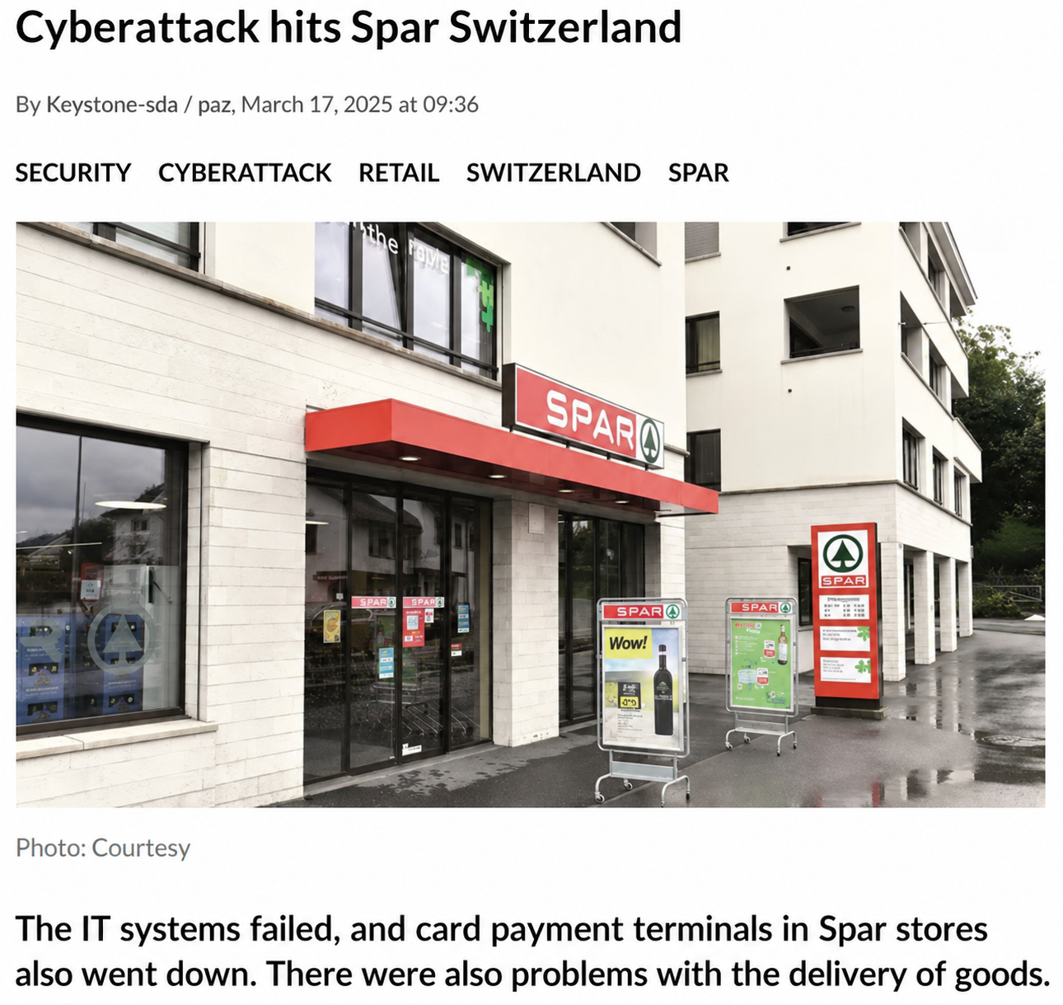
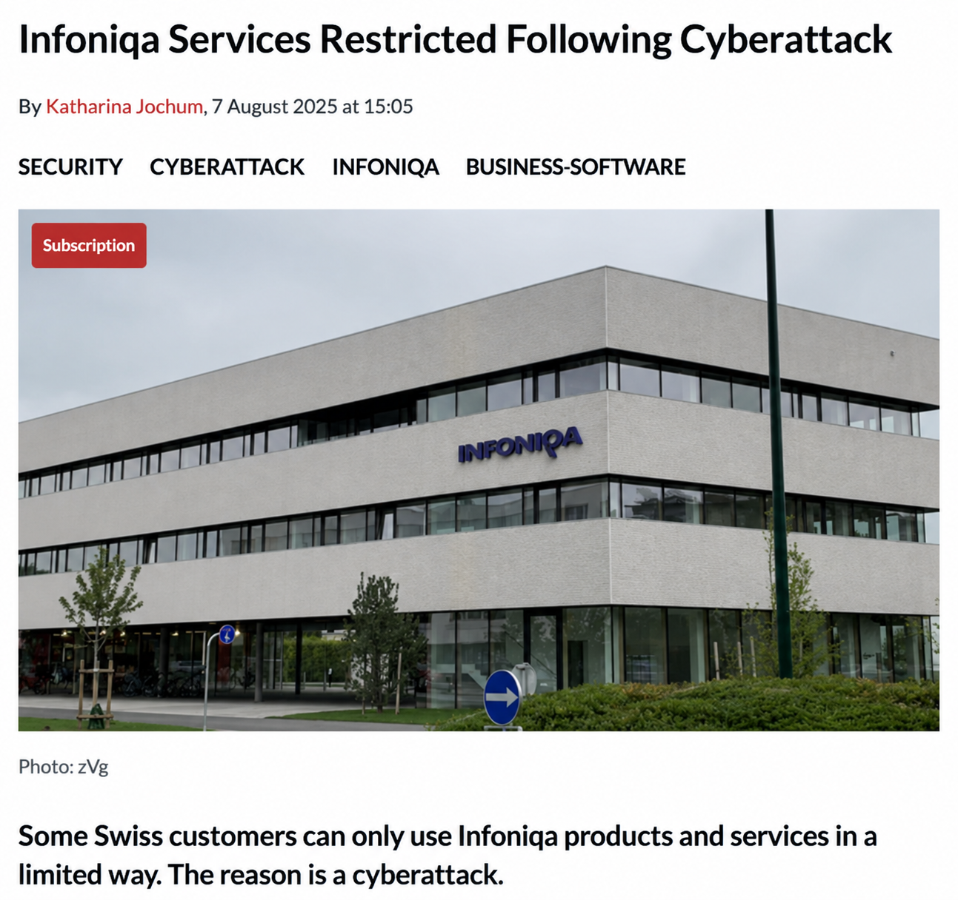
Microsoft EMS Community · September 2026

Slide 9

over 52% of cyberattacks with known motivations are driven by extortion and ransomware
Microsoft Digital Defense Report, 2025
Microsoft EMS Community · September 2026

Slide 10
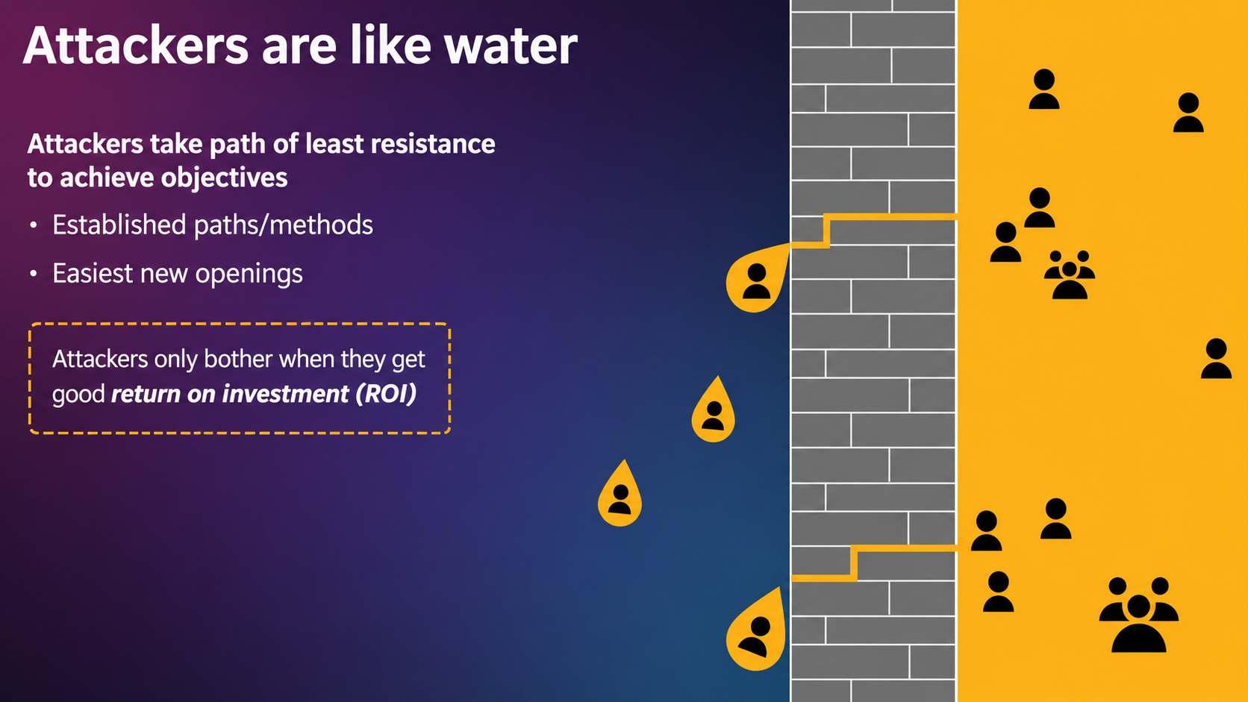
Microsoft EMS Community · September 2026
10

Slide 11


Secure Identities
Secure Endpoints
Microsoft EMS Community · September 2026

Slide 12
Defender?
👍
👍
Microsoft EMS Community · September 2026

Slide 13
How do i start?
Microsoft EMS Community · September 2026

Slide 14
Defender for Office 365
Defender for IoT (& OT)
Microsoft Entra
ID Protection
Defender for Cloud Apps
IoT Device Exploitation
Disrupt OT Environment
Phishing
mail
Open attachment
Brute force account or use stolen account credentials
Attacker accesses sensitive data
Exfiltration of data
Defender for Endpoint
Defender for Identity
Exploitation and Installation
Command and Control
Attacker collects reconnaissance & configuration data
Domain compromised
Click a URL
User account is compromised
Browse a website
Microsoft Defender for Cloud
Attacker attempts lateral movement
Privileged account compromised
Microsoft Defender XDR + Microsoft Sentinel
Security Copilot (Preview)
Leading indicators
Insider risk management
History of violations
Data leakage
Distracted and careless
Disgruntled or disenchanted
Potential sabotage
Insider has access to sensitive data
Anomalous activity detected
Subject to stressors
Microsoft EMS Community · September 2026

Slide 15
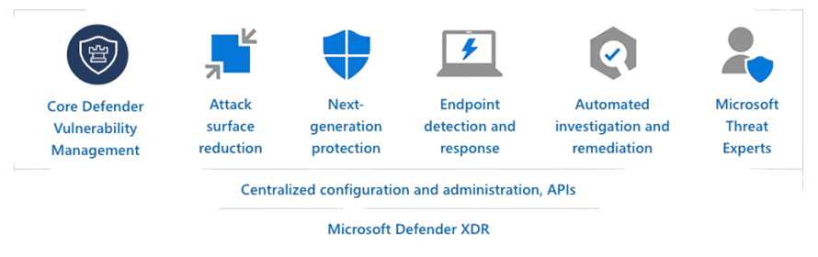
Extended Detection & Response
Microsoft EMS Community · September 2026

Slide 16
Licensing
Microsoft EMS Community · September 2026

Slide 17

Defender for Business
MDE P1
MDE P2
Microsoft EMS Community · September 2026

Slide 18
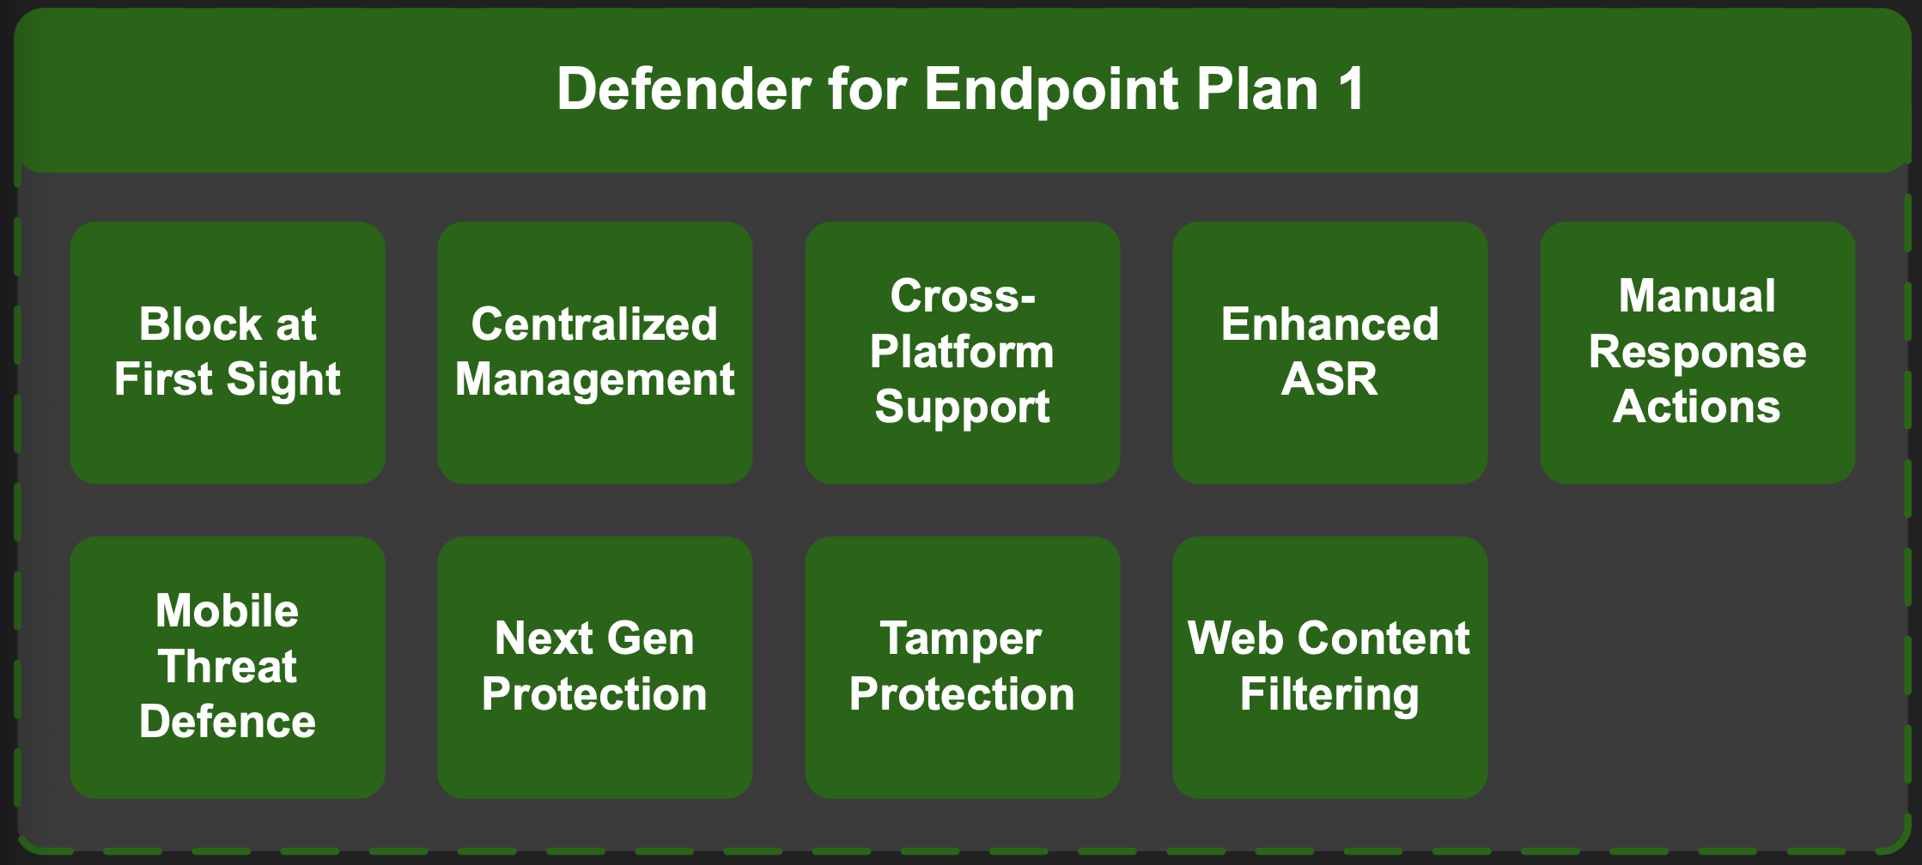
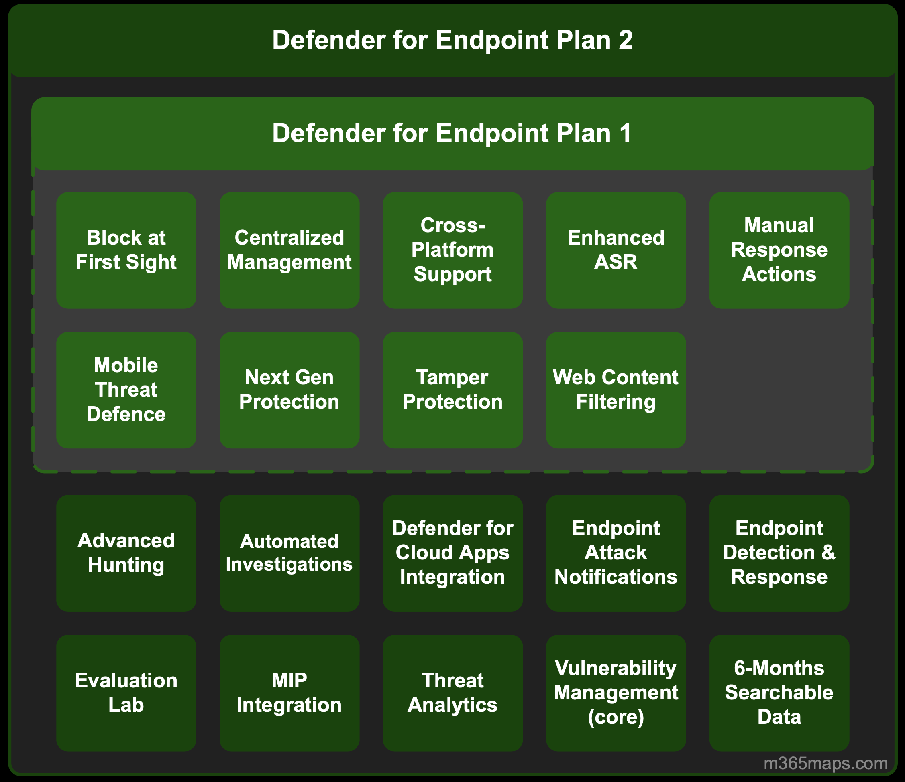
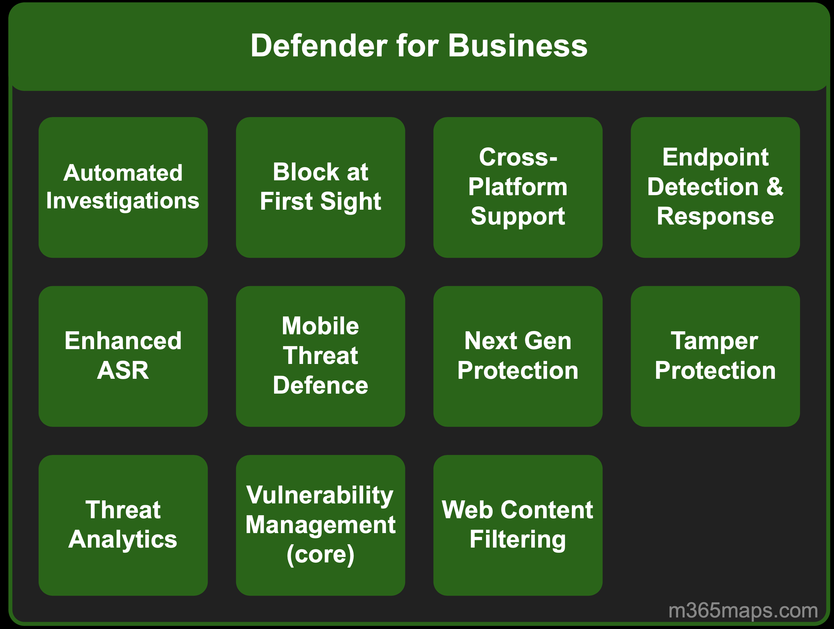
Licensing
Defender for Endpoint P1
Defender for Endpoint P2
Defender for Business
Next Gen AV
EDR
Misc. / 300 seat limit for SMB
Microsoft EMS Community · September 2026

Slide 19
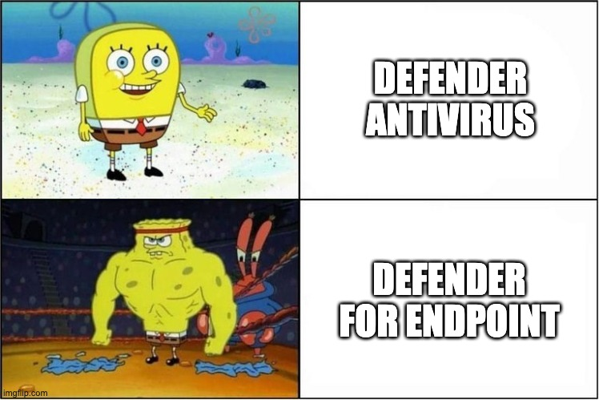
Microsoft EMS Community · September 2026

Slide 20
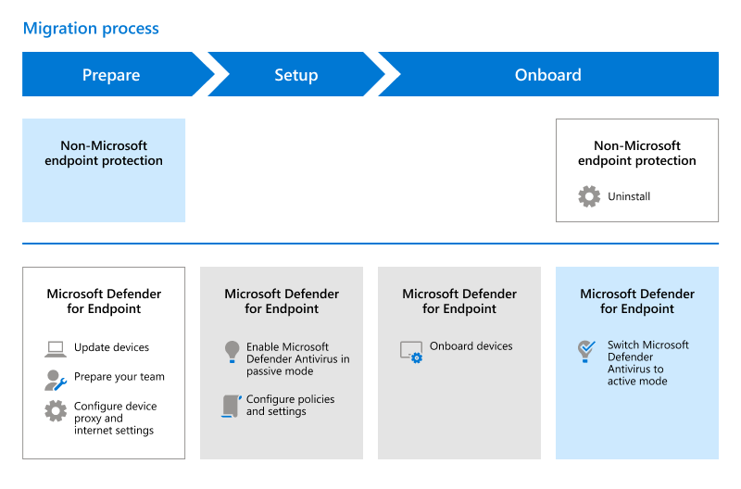
Microsoft EMS Community · September 2026

Slide 21
First Step
Microsoft EMS Community · September 2026

Slide 22
Advanced Features
Device Groups
Notifications
Basic config. MDE
Alert → Notification→Action
Device Groups for Deploying Indicators etc.
Web Content Filtering
Intune Connector
Indicators
Web Filtering on endpoints
Intune and Defender Share Data, e.g Machine Risk Score
Customs IoCs
Deceptions
RBAC
Policies
Honeypots to Decieve Attackers
Roles for Specific Security Tasks
Intune Policies, GPOs
Microsoft EMS Community · September 2026

Slide 23
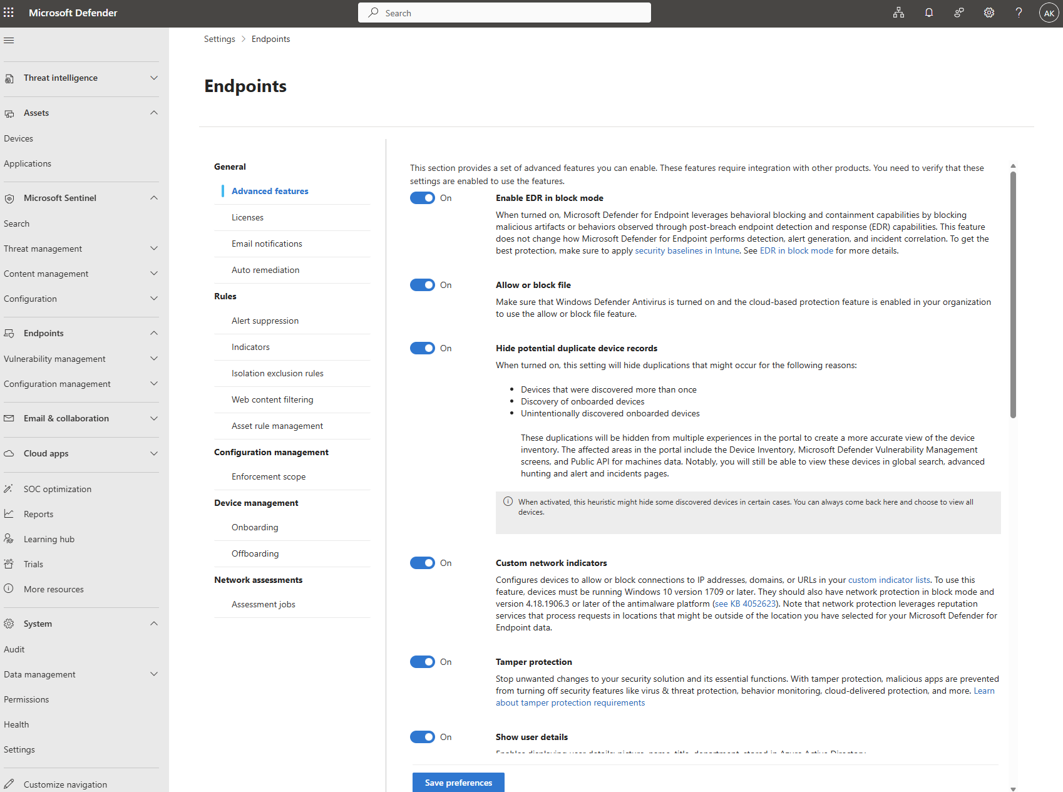
Microsoft EMS Community · September 2026

Slide 24
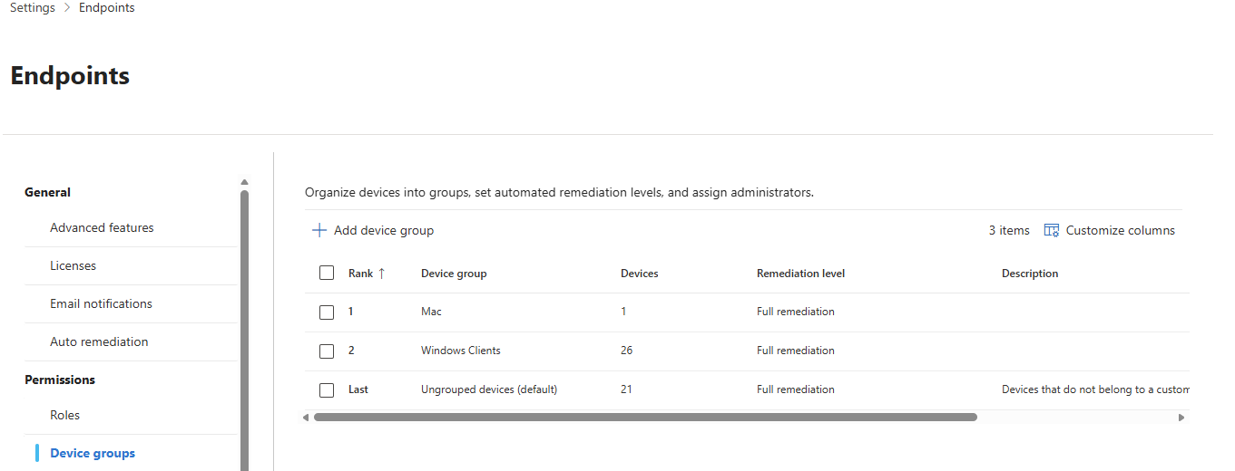
Microsoft EMS Community · September 2026

Slide 25
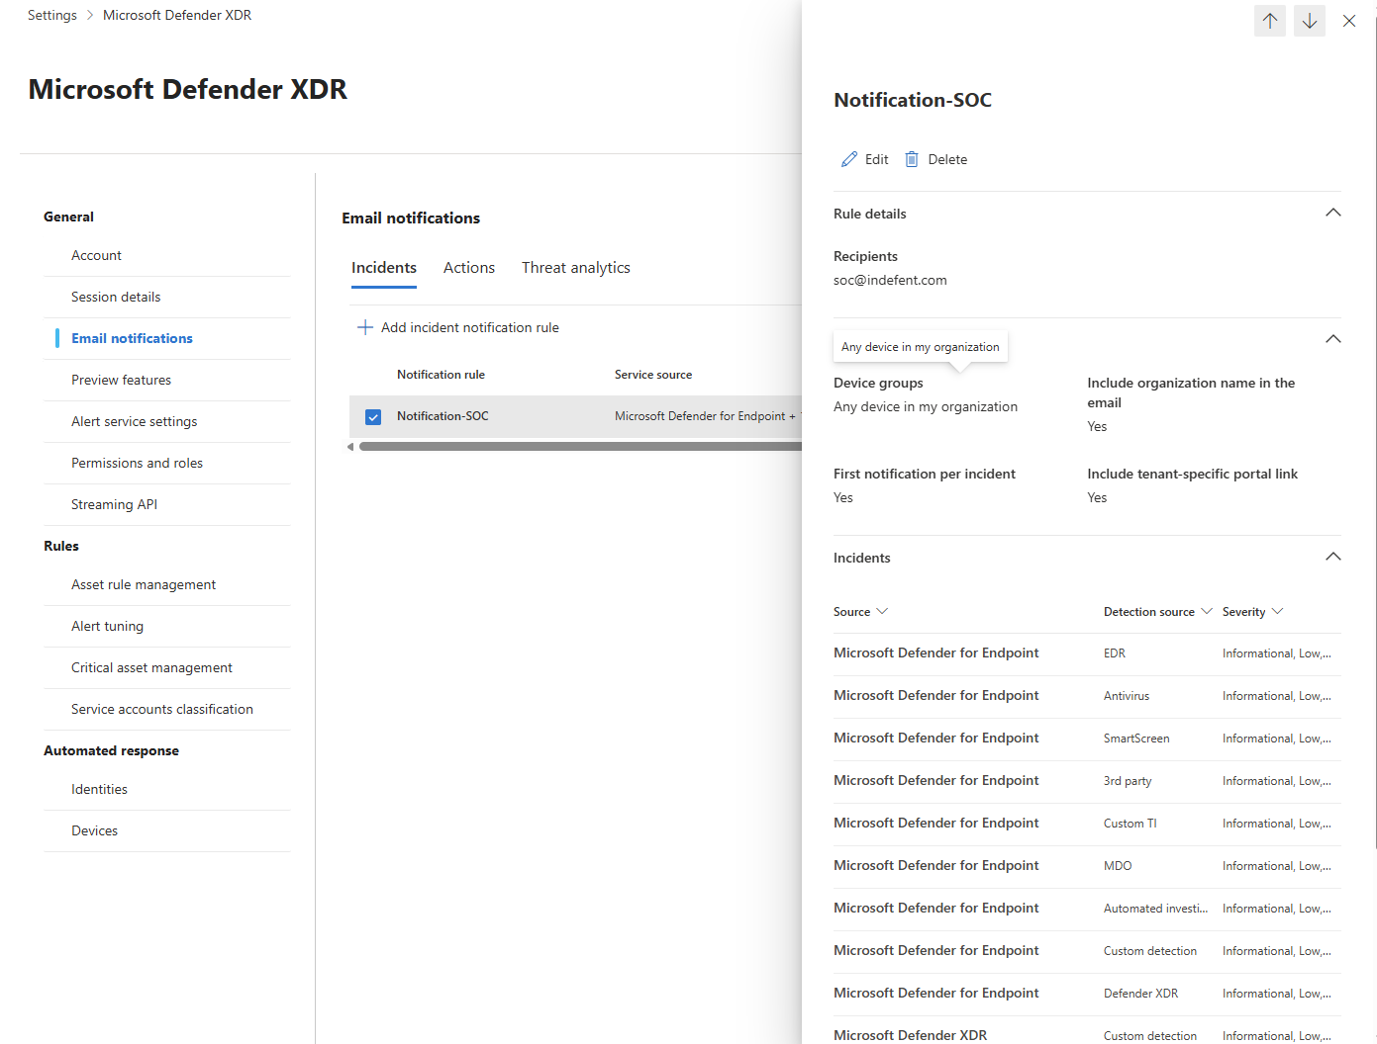
Microsoft EMS Community · September 2026

Slide 26
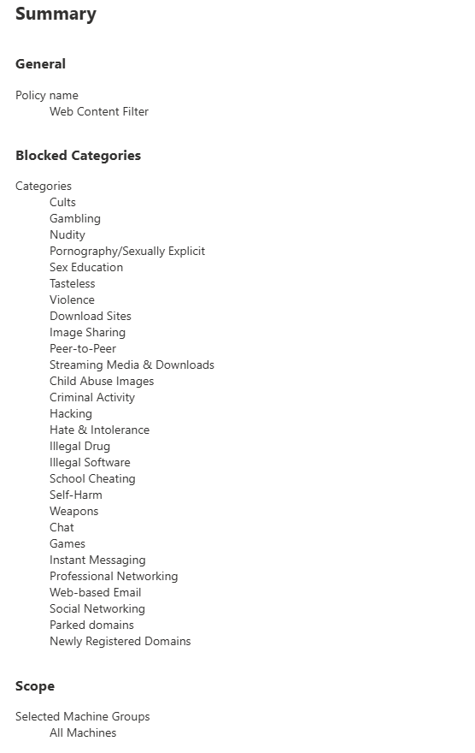
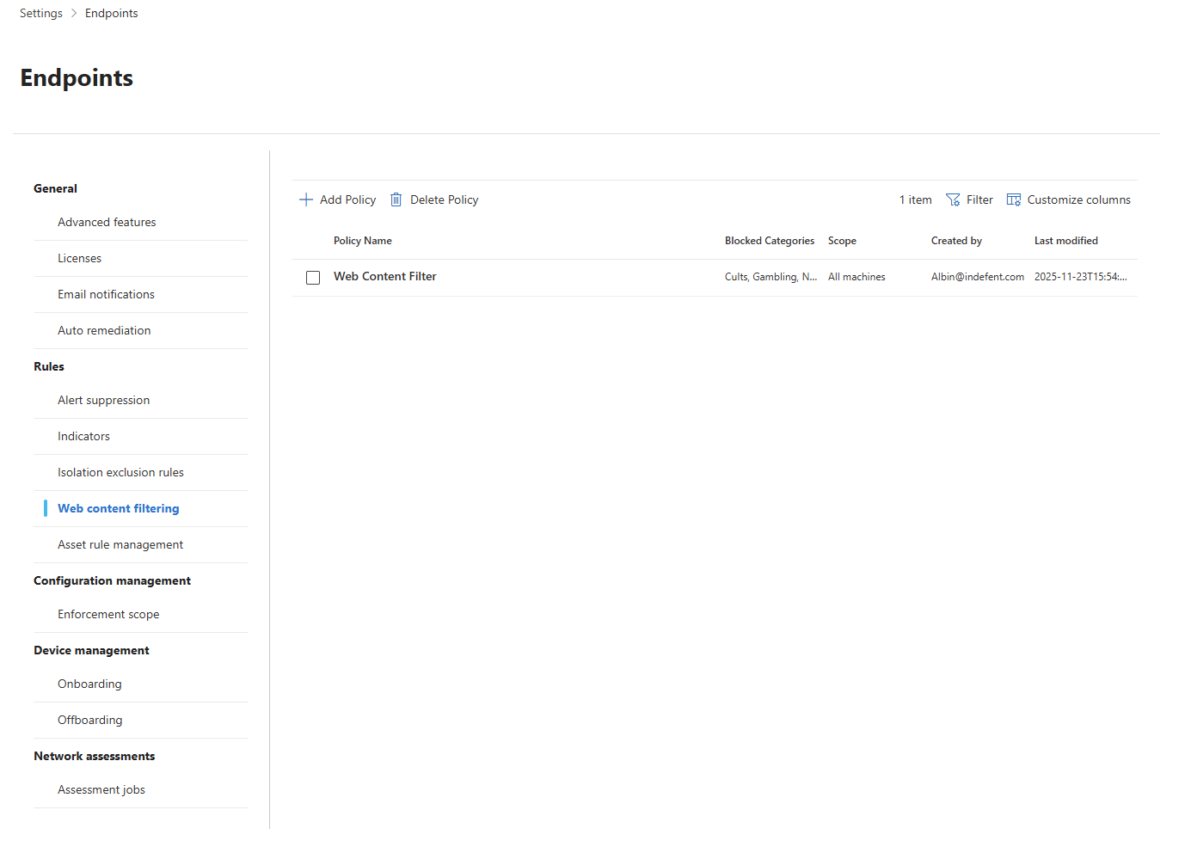
Microsoft EMS Community · September 2026

Slide 27
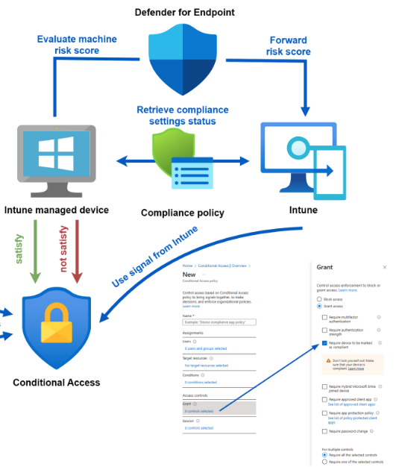
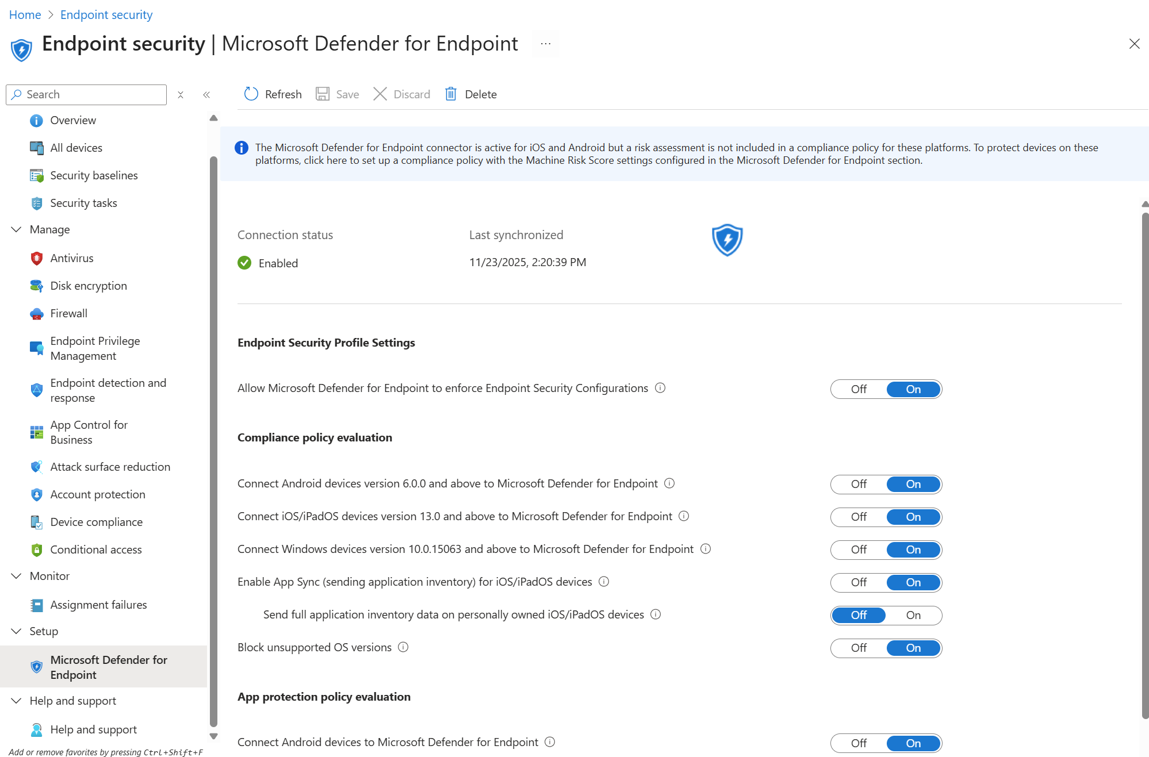
Microsoft EMS Community · September 2026

Slide 28
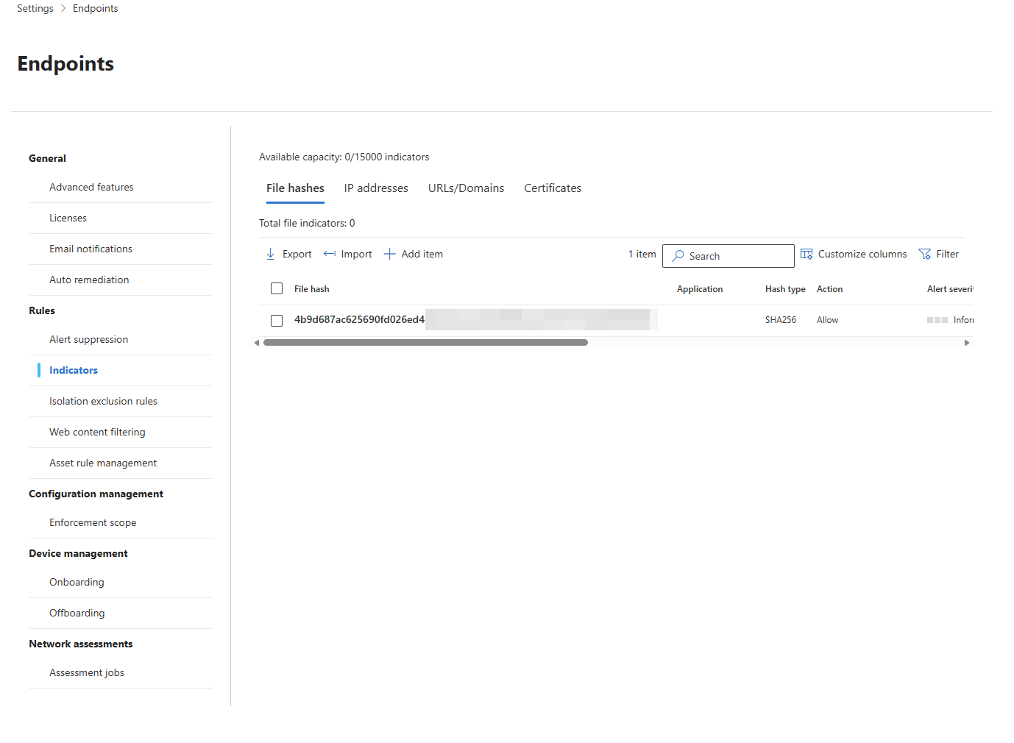
Microsoft EMS Community · September 2026

Slide 29
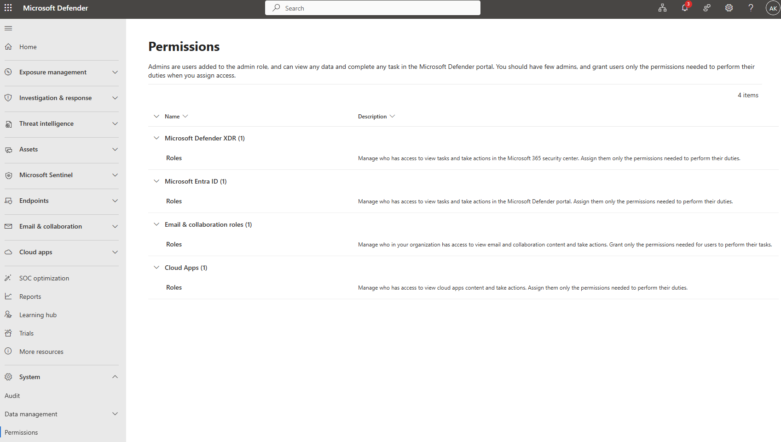
Microsoft EMS Community · September 2026

Slide 30
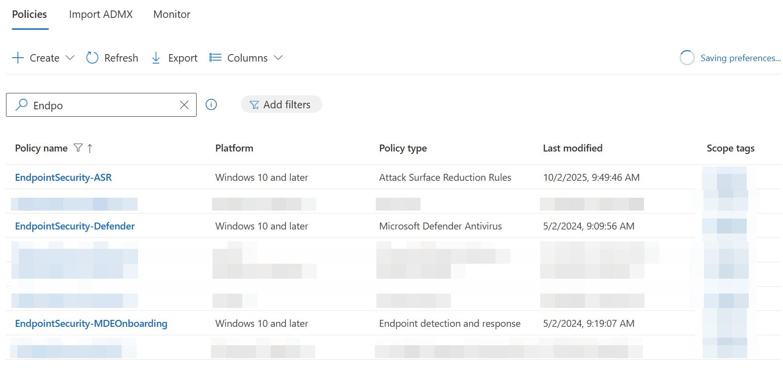
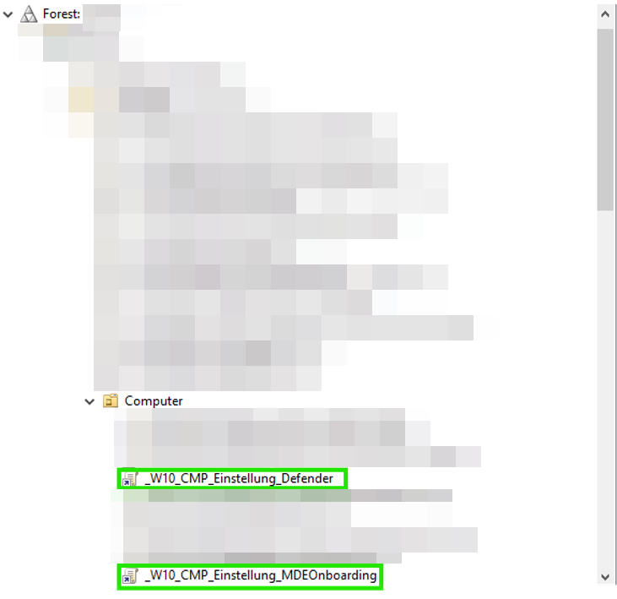
Microsoft EMS Community · September 2026

Slide 31
Understanding features and Licensing
Audit 4 ever
No ASR, EDR - Misconfigurations
Deployment (Downlevel Server)
Live Response Auditing
Tamper Protection
Exclusions
Use of the dashboard only in case of incidents
No plan, strucure, no design
Requirements for IoCs
Enforcement Scope
No updates in passive mode
Troubleshooting Mode
Common Mistakes
Microsoft EMS Community · September 2026

Slide 32
①
Understanding features and licensing, continuosly implementing new features
Block Mode, Audit
PUA Protection
EDR
Tamper Protect
Cloud Protection
Microsoft EMS Community · September 2026

Slide 33
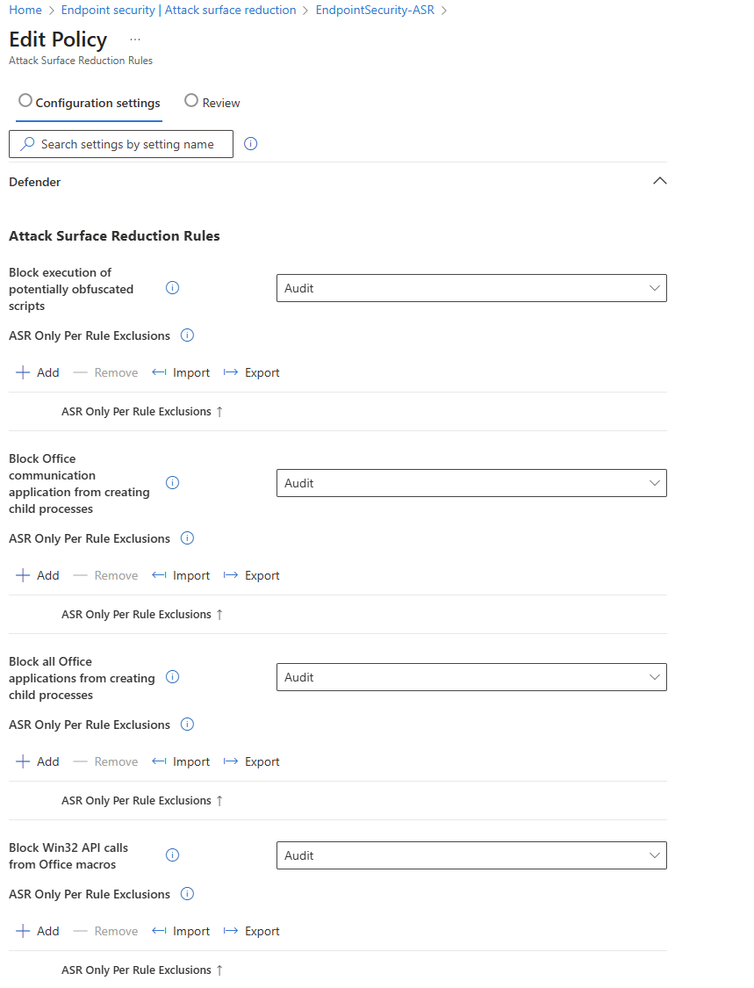
②
Audit 4 ever
Microsoft EMS Community · September 2026

Slide 34
③
No ASR, EDR- Misconfigurations
Microsoft EMS Community · September 2026

Slide 35
④
Deployment (Downlevel Server)
• All systems must be up to date — outdated systems are known to cause various issues during onboarding.
• The Servicing Stack Update (SSU) and Latest Cumulative Update (LCU) must be installed correctly.
• Windows Server 2016 in particular can cause issues if the SSU/LCU are not on the required version.
Recommendations for Server 2012 R2 & 2016
• Use the Microsoft script mdefordownlevelserver to help prevent issues.
• Even better: Upgrade to a current Windows Server OS. ;-)
Microsoft EMS Community · September 2026

Slide 36
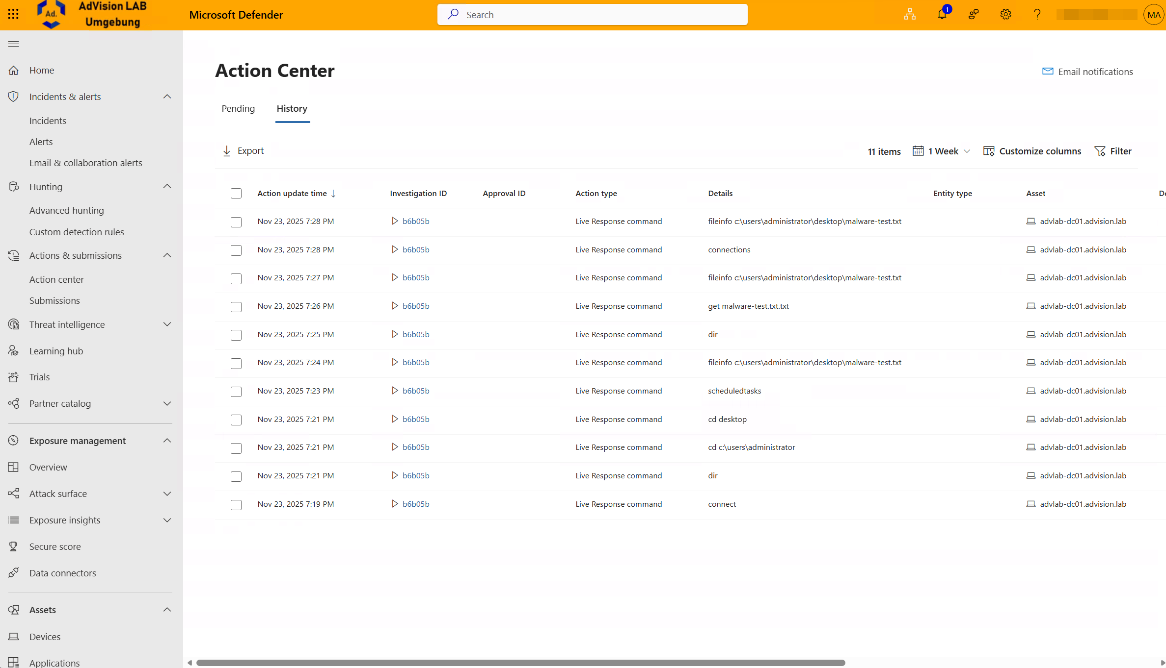
⑤
Live Response Auditing
Microsoft EMS Community · September 2026

Slide 37
⑥
Tamper Protection
Microsoft EMS Community · September 2026

Slide 38
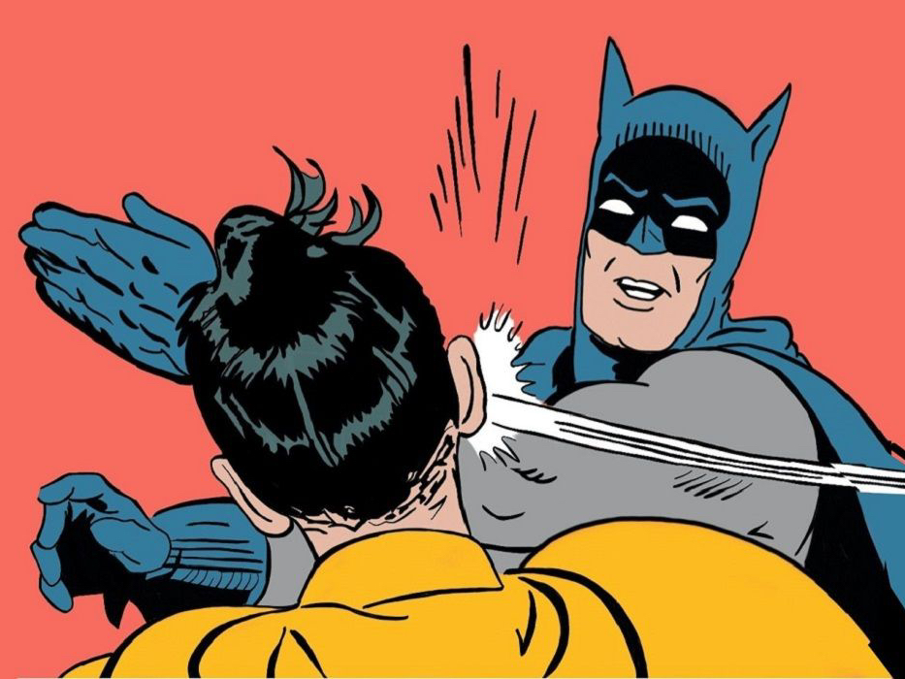
⑦
Endpoint Geek
Please exclude D:\somestupidsoftware\* from Defender…
Exclusions
Some confident Software Rep
Microsoft EMS Community · September 2026

Slide 39
⑧
No plan, Structure, no design
Microsoft EMS Community · September 2026

Slide 40
⑨
Use of dashboard only in case of incidents
Microsoft EMS Community · September 2026

Slide 41
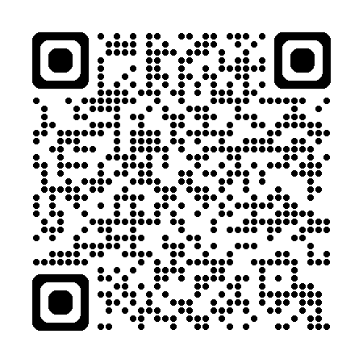
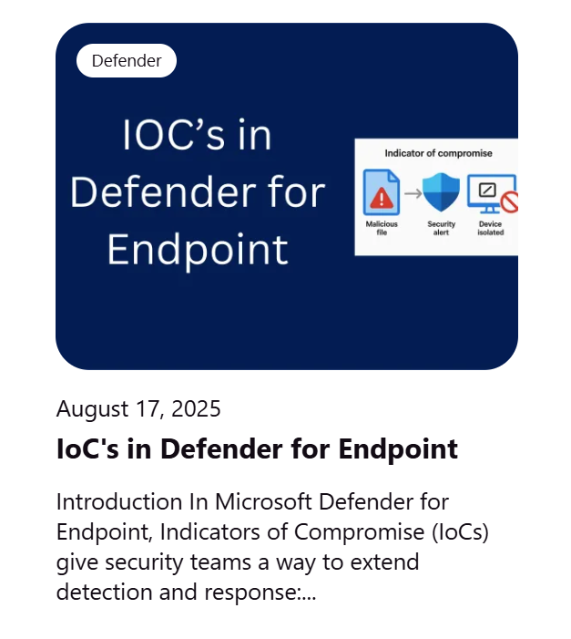
①⓪
Requirements for IoCs
Microsoft EMS Community · September 2026

Slide 42
①①
Enforcement Scope
Solves the following problem
Servers and clients in the DMZ → are/should be unmanaged not domain joined
Microsoft EMS Community · September 2026

Slide 43

Microsoft EMS Community · September 2026

Slide 44
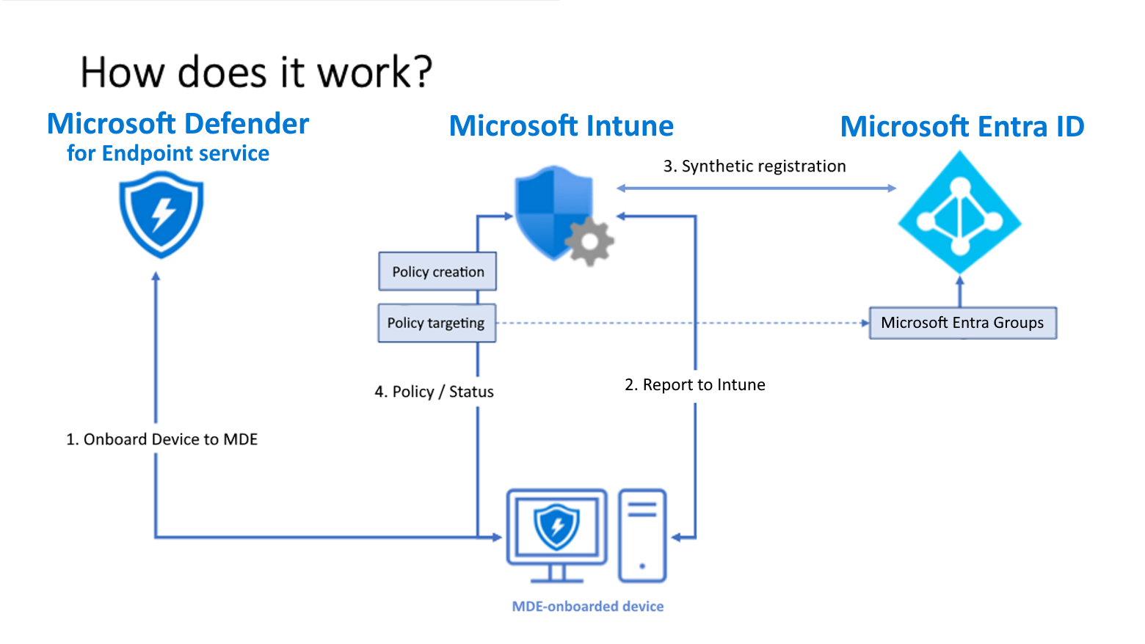
Microsoft EMS Community · September 2026

Slide 45
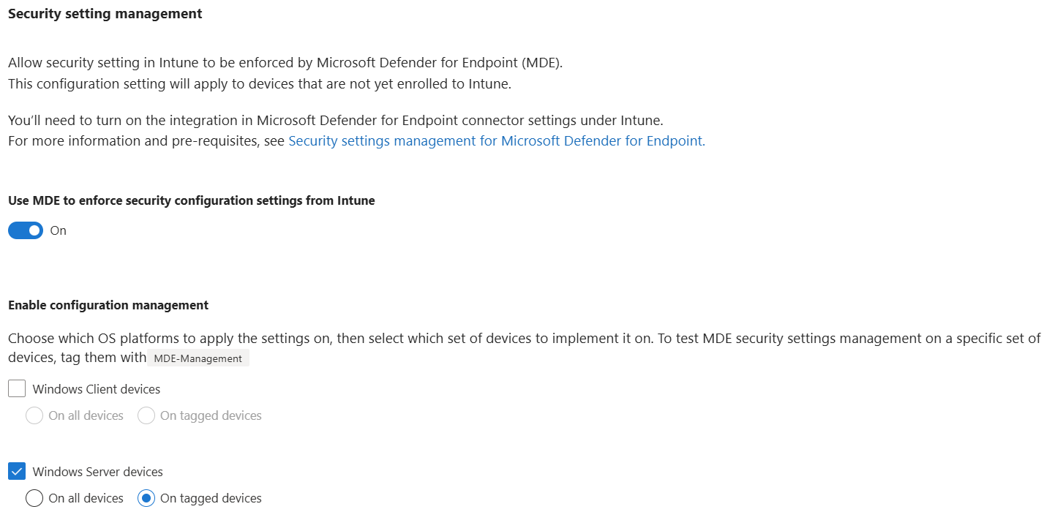
Microsoft EMS Community · September 2026

Slide 46
Licensing → Defender for Endpoint Servers (per server)
Enforcement Scope → Enable
Asset Rule → Create
New Group in Entra → Create
Create New Policies in Intune → Endpoint Security – Defender – MDE Management / Assign the created Entra group to the policy
Onboarding → Via script
Device Appears in Defender → Check or set the MDE-Management tag
Add the device to the created Entra group or check the Dynamic Rule
Check the Defender settings on the server
Microsoft EMS Community · September 2026

Slide 47
①②
No updates in passive Mode
Microsoft EMS Community · September 2026

Slide 48
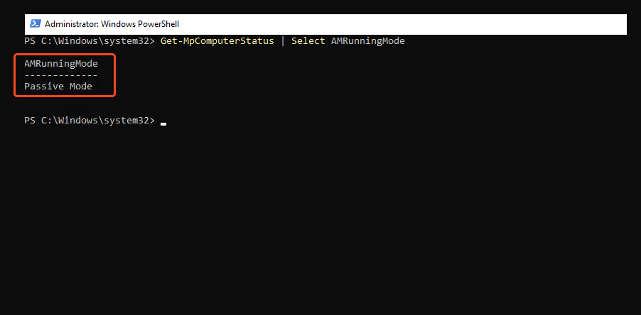
Microsoft EMS Community · September 2026

Slide 49
①③
Troubleshooting & Troubleshooting Mode
Microsoft EMS Community · September 2026

Slide 50
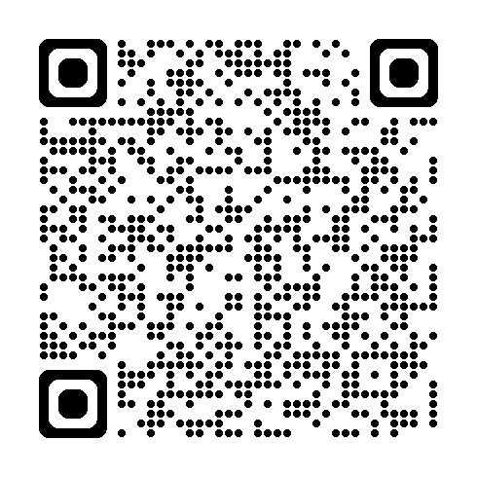
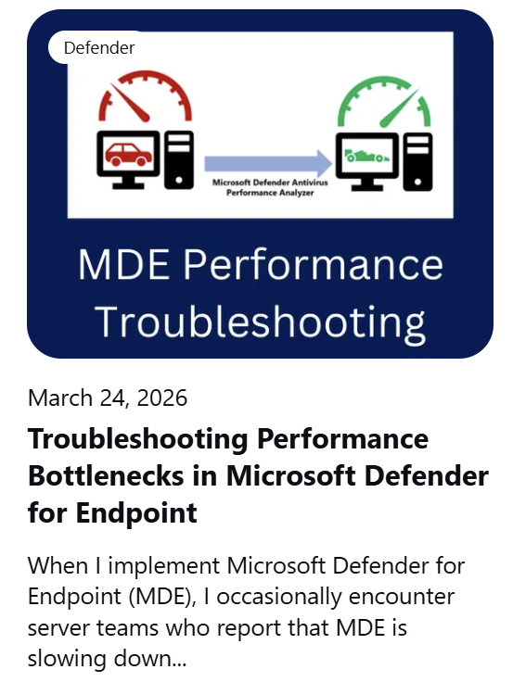
Troubleshooting Guide
Microsoft EMS Community · September 2026

Slide 51
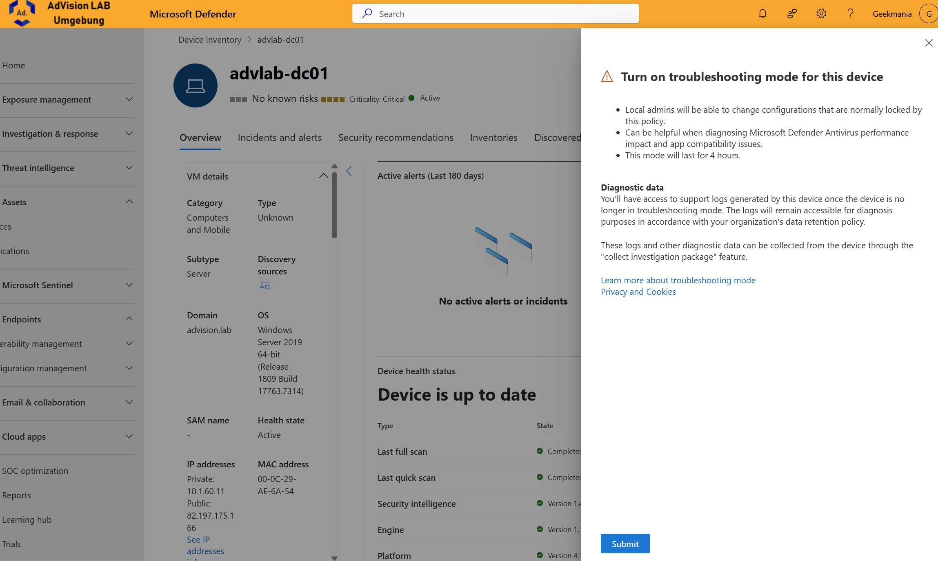
Microsoft EMS Community · September 2026

Slide 52
Tips from the field
Microsoft EMS Community · September 2026

Slide 53
Preparation is key → Discover the servers and assess their current status
Use reports → Check the health status after migration
2012 R2, 2016 → Avoid ;-)
Microsoft EMS Community · September 2026

Slide 54
Microsoft EMS Community · September 2026

Slide 55
Preparation is key → Discover the servers and assess their current status
Use reports → Check the health status after migration
2012 R2, 2016 → Avoid ;-)
Use ASR consistently → Set to Block whenever possible
Tamper Protection → Always enabled
Automated I & R → Full Remediation
Alerts → Optimize them; beware of alert fatigue
Complexity → Be cautious with configurations when MDAV is running in Passive Mode / keep EDR in Block Mode enabled
Security Portal → Make use of all available insights and telemetry
Exclusions → Use sparingly
Microsoft EMS Community · September 2026

Slide 56
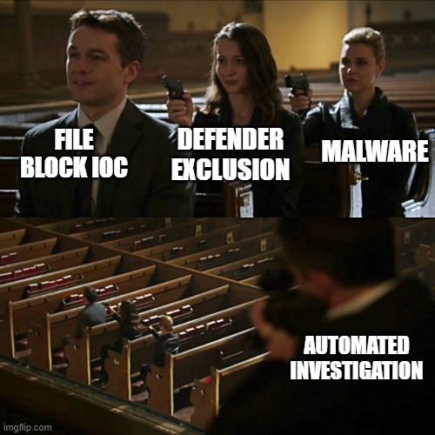
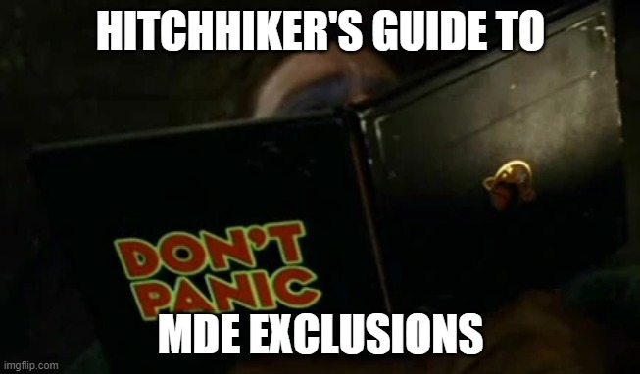
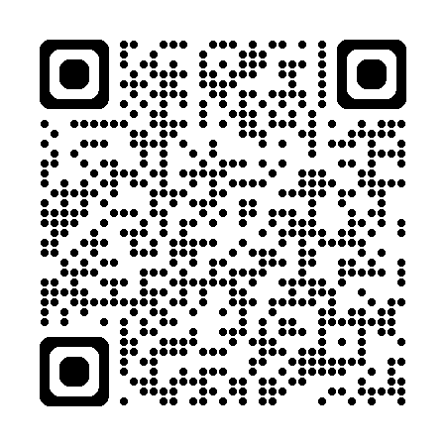
Microsoft EMS Community · September 2026

Slide 57
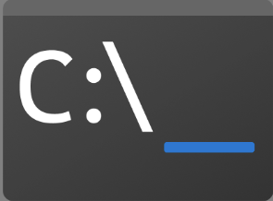
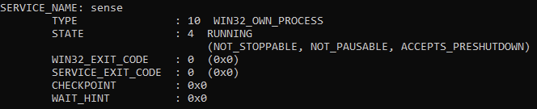
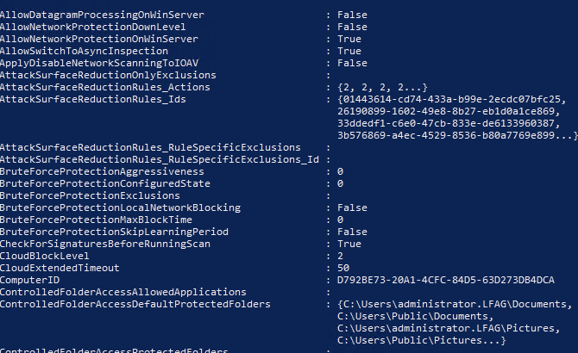

sc query sense
Get-MPpreference
Microsoft EMS Community · September 2026

Slide 58


Microsoft EMS Community · September 2026

Slide 59
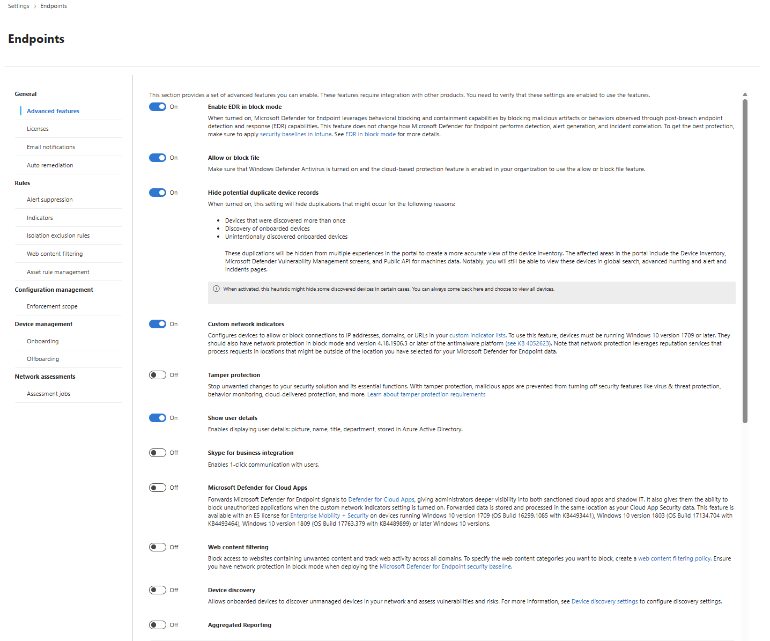

Microsoft EMS Community · September 2026

Slide 60
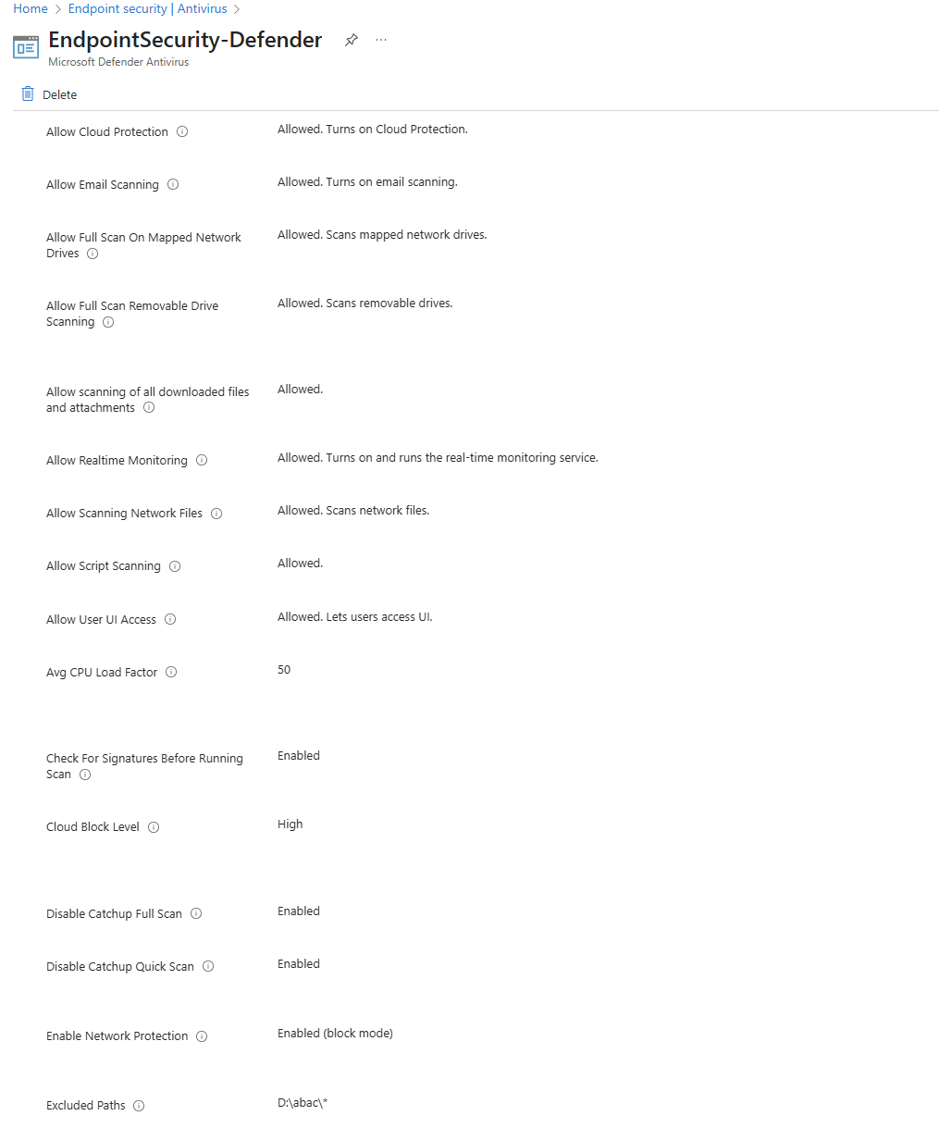
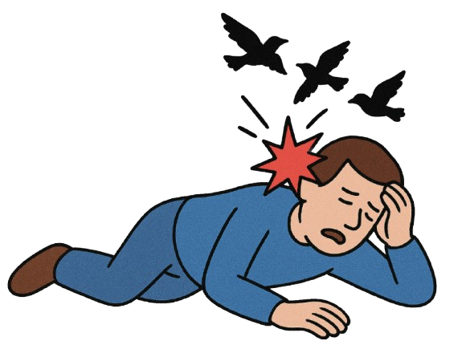
Microsoft EMS Community · September 2026

Slide 61
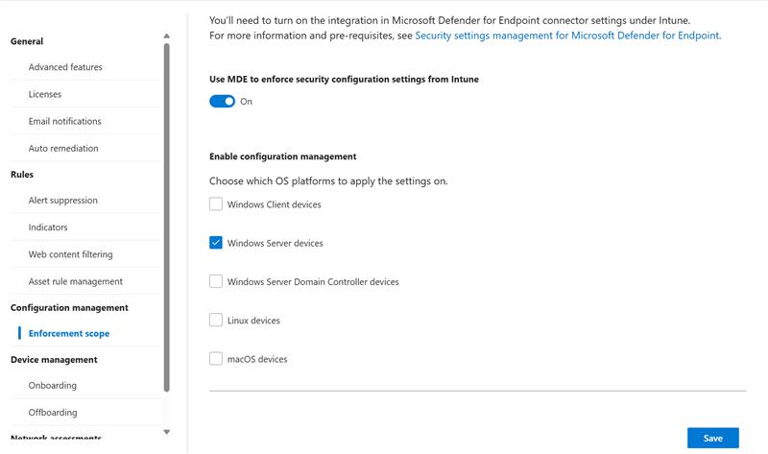
Microsoft EMS Community · September 2026

Slide 62
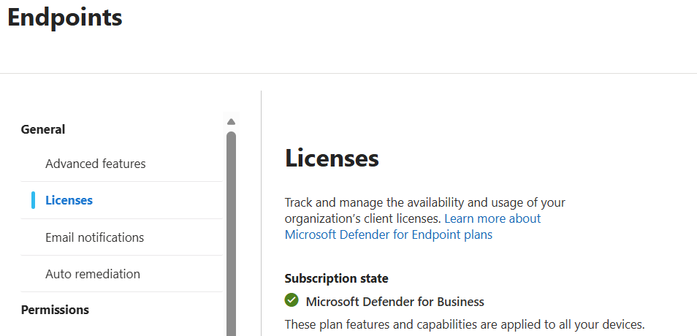
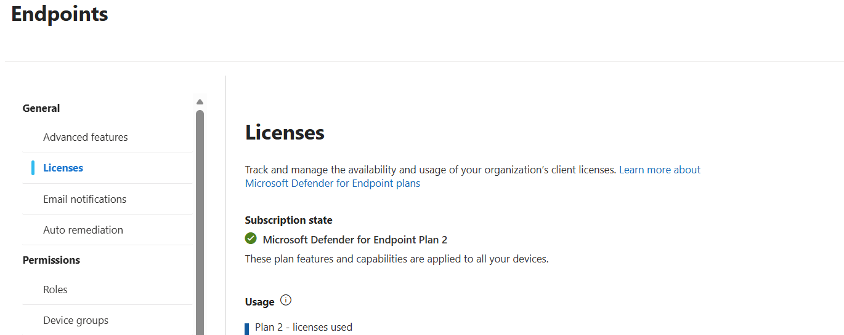
Microsoft EMS Community · September 2026

Slide 63
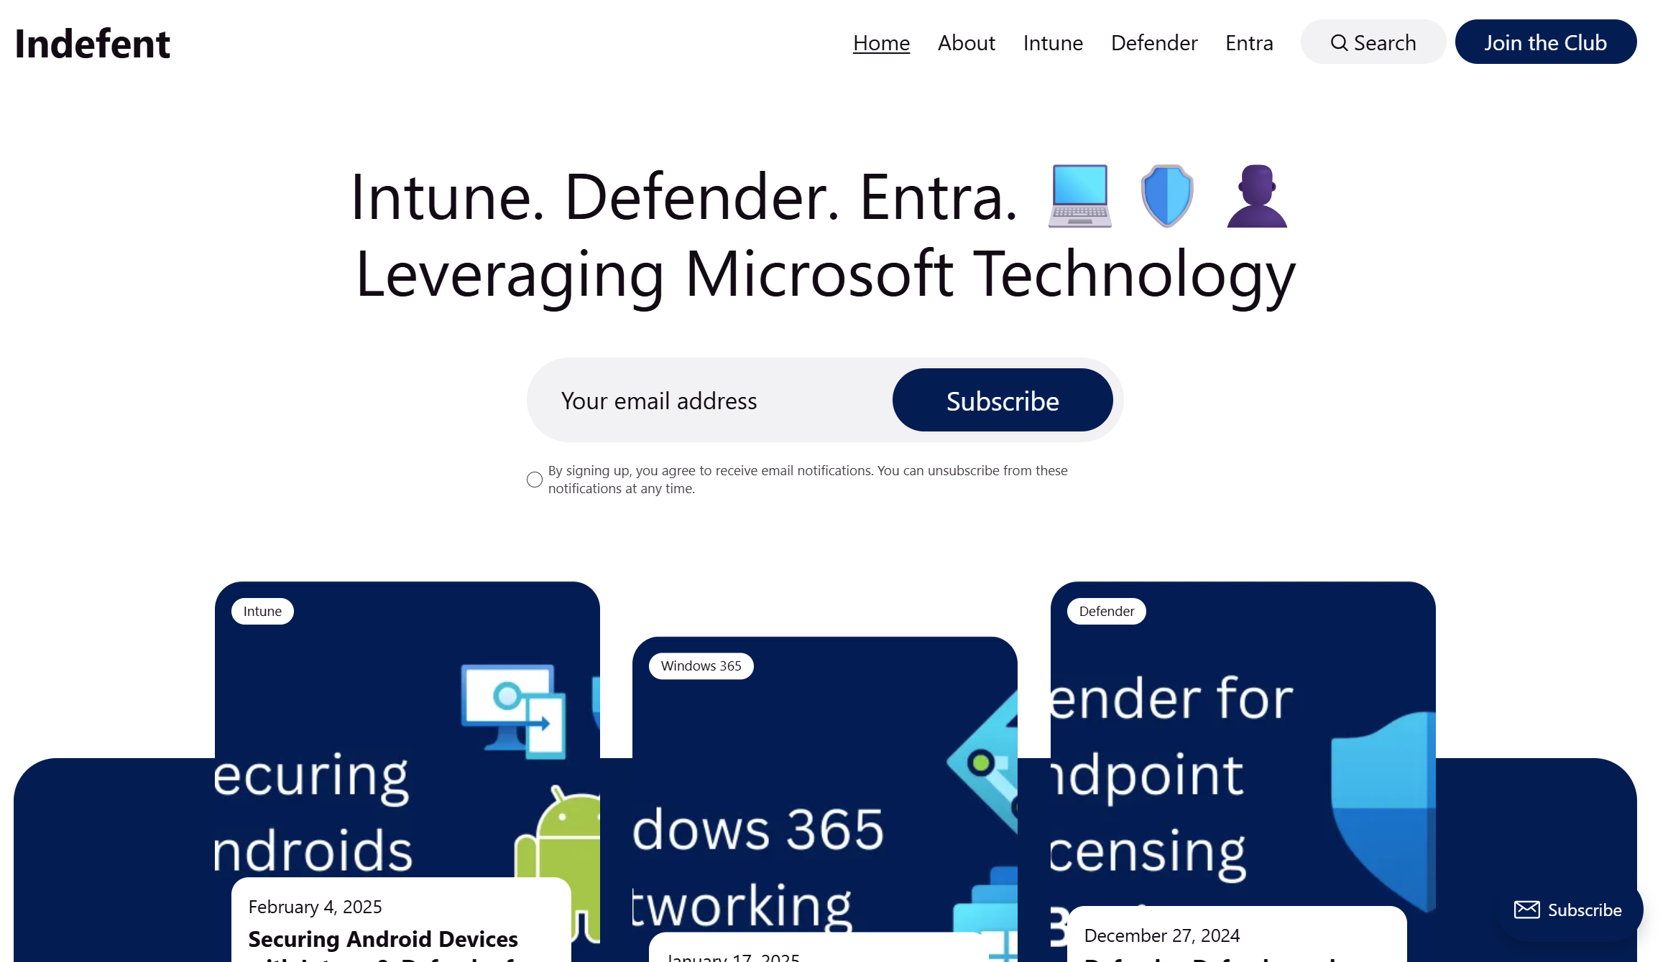
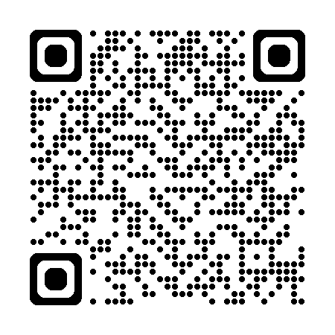
Microsoft EMS Community · September 2026

Slide 64
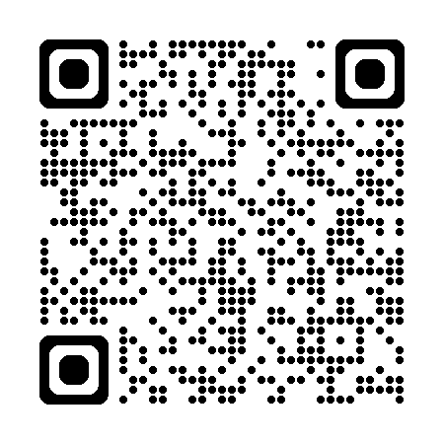
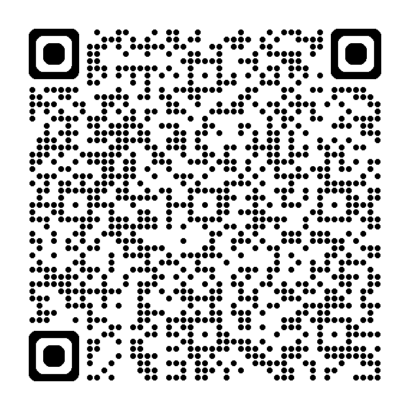
SOCRadar
Microsoft
Microsoft EMS Community · September 2026

Slide 65
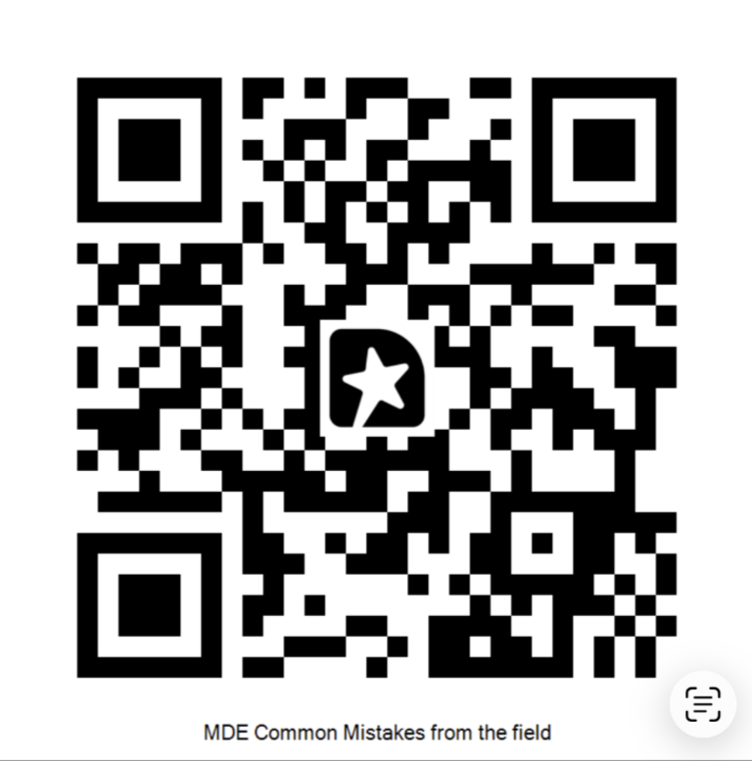
MICROSOFT EMS COMMUNITY
Thank you
aka.ms/M365EMSDiscord
msems.community
Independent and community-run. Not affiliated with, endorsed by, or sponsored by Microsoft. Product names are trademarks of the Microsoft group of companies.
Notes:
Wrap up. Discord https://aka.ms/M365EMSDiscord and https://www.msems.community/

